Slide 1
Intro to Java
JUMP June 2019
Draft: 07/02/2019

Slide 2
Table of Contents
Using STS to create our code samples and exercises
Java 101
Data Types and Operators
Program Control Statements
Classes, Objects and Methods
Data Types and Operators (Part 2)

Slide 3
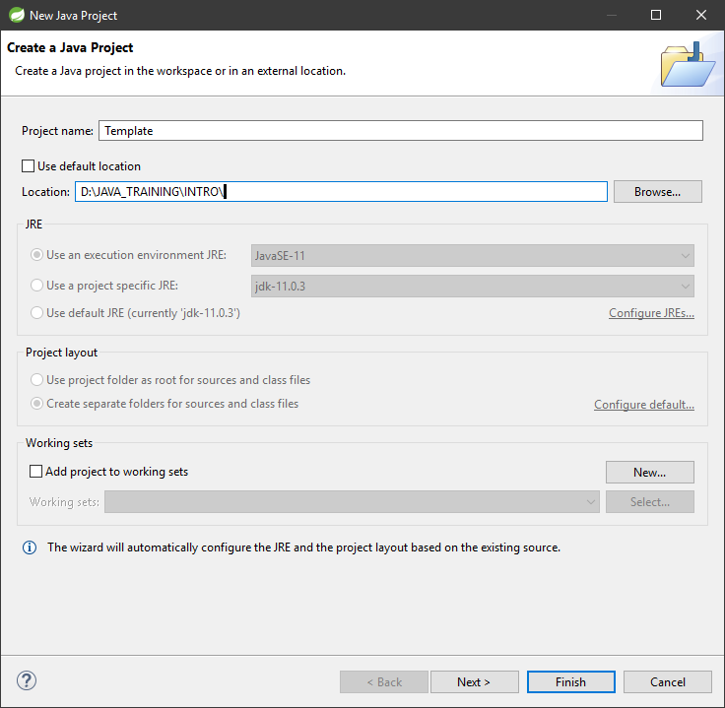
Using STS to create our code samples and exercises (1 of 5)
Use this ‘templated’ approached to create all your code samples and exercises, until otherwise instructed.
In STS
File… New… Java Project
Add a Project Name
Set up a directory to store the project
Click Finish.

Slide 4
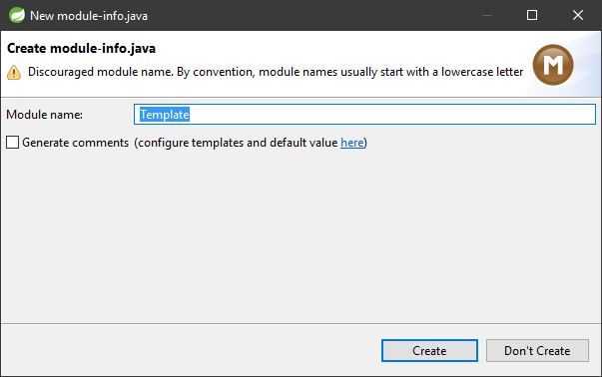
Using STS to create our code samples and exercises (2 of 5)
Click Don’t Create for New module-info.java

Slide 5
Using STS to create our code samples and exercises (3 of 5)
In the Package Explorer pane, there should be a “Template” folder. Expand it and context-menu click the src folder.
Select the New… Class..

Slide 6
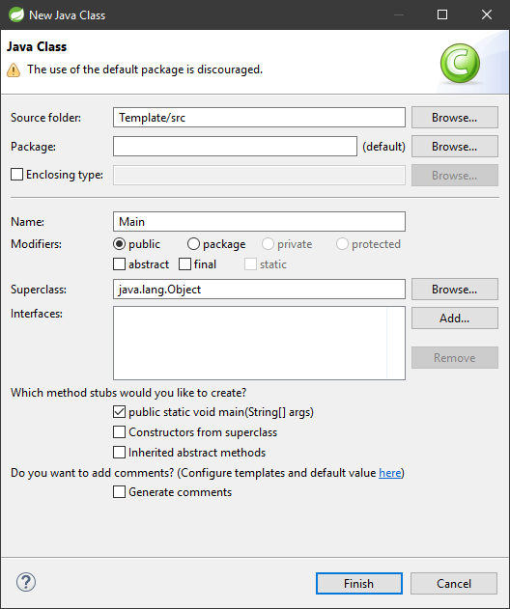
Using STS to create our code samples and exercises (4 of 5)
Ensure you have the following:
Name: “Main”
The “public static void main(String[] args) checkbox selected.
Even though the use of ‘default’ package is discouraged, until otherwise instructed, just ensure your options are as per the graphic next to this text
Click Finish.

Slide 7
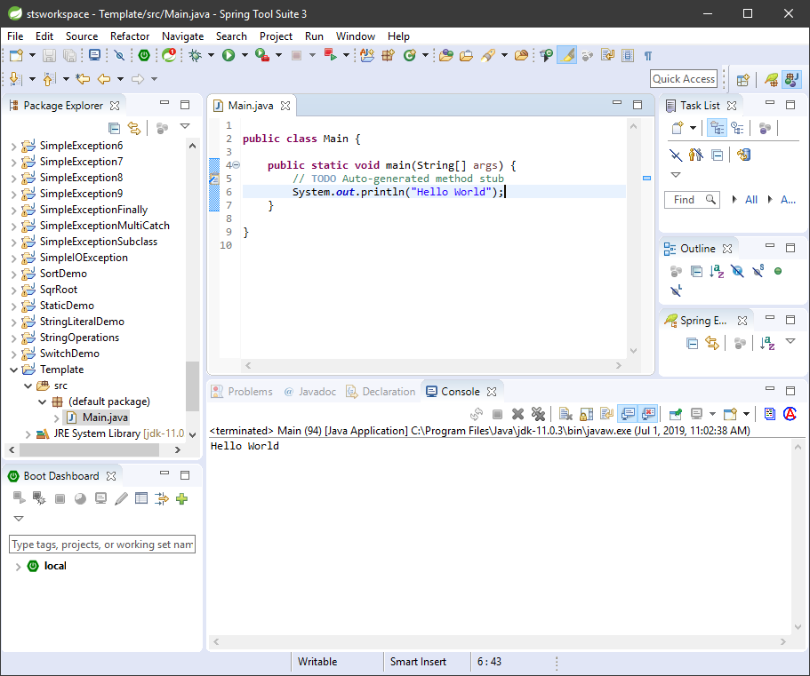
Using STS to create our code samples and exercises (5 of 5)
We will quickly test to ensure we can use STS’s console to output a “Hello World” message, meaning we can build and execute our Java code.
Insert the code below into the Main function
System.out.println(“Hello World”);
Save the file.
Select “Run” from the top menu and the Run command in the list.
Should expect the code to execute, see the graphic on the right
P.S. (you may need to ensure you can view the “Console”, this is located under Window… Show View… Console.

Slide 8
Java 101
Bytecode
Buzzwords
OOP
First Program
Syntax Errors
Second Program
Another Data Type To Play With
Control Statements
Blocks of Codes
Pesky Semi Colons and Code Position
Indentation is your Friend
Restricted Java Keywords
Identifiers in Java
The Java Class Libraries

Slide 9
Java 101 - Bytecode
Java can be compiled to run on any computer which can support the Java language
The “Bytecode” is a highly optimized set of instructions designed to be executed by the Java run-time system which is called Java Virtual Machine (JVM). The JVM interprets bytecode.
JVM allows for portable programs, this is a huge bonus, no code needs to be “native”.
JVM provides safety and restrictions
HotSpot is a just-in-time (JIT) compiler for bytecode. JIT is part of the JVM
JIT only compiles bytecode that will benefit from compilation

Slide 10
Java 101 - Buzzwords
Simple | Java provides a concise set of features which facilitates learning and using it
Secure | Java provides a secure means of creating Internet apps.
Portable | Java programs can execute in any environment that provides Java run-time system (JRE)
Object-oriented | Java is a true object oriented programming language
Robust | Java is strongly type and promotes error-free programming by performing run-time checks
Multithreaded | Java provides the ability to support multithread programming and execution
Architecture-neutral | Java is not tied to any specific system/operating system architecture
Interpreted | Java supports cross-platform code execution via the use of Java Bytecode executing using Java Virtual Machine (JVM)
High performance | The Bytecode is a highly optimized token designed for speed of execution
Distributed | Java is designed for the Internet which is an ideal environment to distribute code and apps
Dynamic | Java apps can carry substantial amounts of run-time type information that is resolved on-the-fly during execution.

Slide 11
Java 101 – Object Oriented Programming (OOP)
Polymorphism 101
From Greek, meaning “Many Forms”
Allows one interface to access a general class of actions
Action is based on the exact nature of the situation
Inheritance
One object inherits the properties and methods of another
Hierarchies allows for defining objects with increased characteristics
Relationship between parent and child
The application to a child is the subclass
The parent is the super class
Create programs organized around the data.
Promote reusability and extensibility
3 common traits of OOP
Encapsulation 101
Bind code and data together (black box)
Private to the object means that the data cannot be access outside its scope
Public means that the object allows its data to be access outside its scope

Slide 12
Java 101 – First Program – Hello World
Going back to the STS setup
Steps were
Enter the Program
Compile the Program
Run the Program
Note: STS was kind enough to ensure the code was compiled and executed with the Run command its IDE provides
Notes
All source files will have an extension *.java
You can use the javac command to compile code from the command prompt
This creates a *.class file
You can use the java command to execute compiled code (compiled into bytecode)
/* */ allow you to enter multiline comments
// allows you to ensure single line comment

Slide 13
Java 101 – First Program – Hello World
Notes
Java is case sensitive!
See the following on coding conventions in Java
http://www.programajama.com/courses/bit115/DocsInterest/CodeConventionsShortSheet.pdf
class Main {}
Code block are always placed with {}
This “class” is defined
public static void main (String args[]) {
main is the function name
void is the return type (returns nothing)
static means that main() can be called before an object of the class is created, in this case, without ‘static’ we wouldn’t be able to execute this app
public is an access modifier and in this case, code outside of the class can access it’s members (properties, methods) and in this case because “main” is called before anything is create by the JVM, it is important to set it as public

Slide 14
Java 101 – First Program – Hello World
Notes
System.out.println("Hello World");
Line outputs the string assigned followed by a new line to the screen. System.out is a predefined class so basic in Java that it incorporates it as a default without having to import the package. The operation of System.out is an I/O operation.

Slide 15
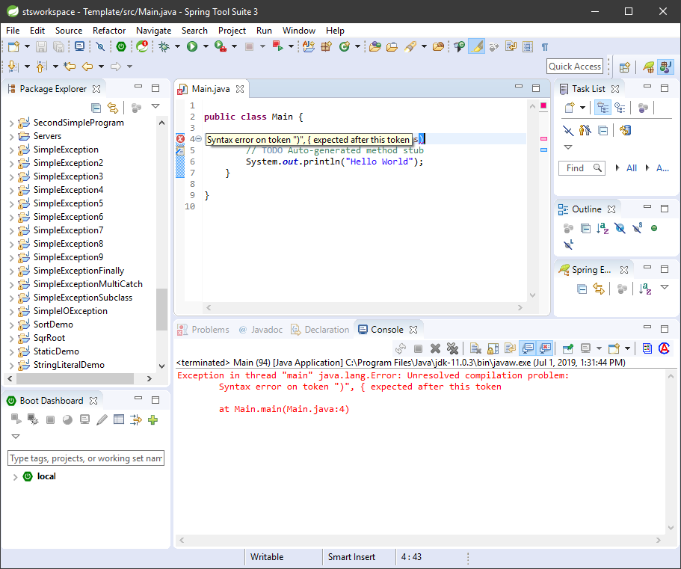
Java 101 – Syntax Errors
Syntax errors happen when you have typos in your code
In an IDE, often, the error is displayed using a warning system
In your console, the compiler will output the error.
Depending on the nature of an error, it may cascade, so it is important to figure out the root cause typically, the first line reported
Often, it is the preceding line that may also causing offense when a syntax error occurs

Slide 16
Java 101 – Second Program
Create another Java project and name it secondProgram
Following the instructions as per the section “Using STS to create our code samples and exercises” of this slide presentation
Add the following code to it’s main class / main() function
Highlights of this code
Uses of “int” to declare data type
Assigning values using the assignment operator “=“
Mathematical function where we are dividing the content of var1 by 2
int var1; // this declares a variable
int var2; // this declares another variable
var1 = 1024; // this assigns 1024 to var1
System.out.println("var1 contains " + var1);
var2 = var1 / 2;
System.out.print("var2 contains var1 / 2: ");
System.out.println(var2);

Slide 17
Java 101 - Another Data Type To Play With
When it comes to numbers there are a few data types available, we can use
“int” ← whole numbers
“float” or “double” ← numbers which contain decimal values
When you run this, you will get 2.0 as an answer because you are dividing a double value with an integer.
Note: the use “print” instead of “println” and everything printed on the same line.
int var1; // this declares a variable
double var2; // this declares another variable as a double
var1 = 10; // this assigns 10 to var1
var2 = 20.0; // this assigns 20.0 to var1
System.out.print("var2 / var1 = ");
System.out.println(var2 / var1); // dividing 2 numbers

Slide 18
Java 101 – Control Statements
int var1; // this declares a variable
int var2; // this declares another variable
var1 = 10; // this assigns 10 to var1
var2 = 20; // this assigns 20 to var2
if(var1 > var2) {
System.out.println("var1 is greater than " + var2);
}
if(var1 < var2) {
System.out.println("var1 is less than " + var2);
}
int x; // this declares x
for(x = 0; x < var1; x = x + 1) {
System.out.println("x: " + x);
}
If statement (branching)
Operators
< Less Than
<= Less Than or Equal
> Greater Than
>= Greater Than or Equal
== Equal
!= Not Equal
for loop (iterating and stopping on a condition)
Follow these steps
Create another Java project and name it controlStatements
Following the instructions as per the section “Using STS to create our code samples and exercises” of this slide presentation
Add the following code to it’s main class / main() function

Slide 19
Java 101 – Blocks of Code
All Blocks of Code in Java are enclosed in { } brackets.
Class
Functions
Control Statements
Error Control

Slide 20
Java 101 - Pesky Semi Colons and Code Position
The semicolon “;” is a separator to terminate individual statements
Blocks of code are not terminated with semicolon
You can place several statements one after another separated by “;”, the compiler doesn’t care, however, it may make your code harder to understand and to debug

Slide 21
Java 101 – Indentation is your Friend
Java is free form.
You can have multiple statements in a single line, separated by semicolon.
You can have blocks of code in a single line also.
But.. The best code is the one where you use indentation as a mean of easily identifying your code’s structure.
Indentation provides a means to easily locate areas of code which are embedded.
Most IDEs and text editors geared towards programming will provide you with tools such as outline features to easily expand/collapse sections of code

Slide 22
Java 101 - Restricted Java Keywords
Restricted keywords mean these words are part of the official vocabulary of Java and/or are reserved for later use as they could potentially become part of the lexicon.
Follow this link to the Wikipedia: https://en.wikipedia.org/wiki/List_of_Java_keywords

Slide 23
Java 101 – Identifiers In Java
In programming languages, identifiers are used for identification purpose. In Java, an identifier can be a class name, method name, variable name or a label.
https://www.geeksforgeeks.org/java-identifiers/

Slide 24
Java 101 – The Java Class Libraries
Java provides predefined classes
Methods such as println() and print() are accessed through System.out.
System is a predefined class by Java that is automatically included in your program.
Classes are imported as packages
The import method is used to include packages into a java program.
Note: In this training, you will learn how to create your own packages, this is one of the main pragmatic feature of Java, which is to create reusable pieces of code that can be added to any program as required.
Ref: https://www.geeksforgeeks.org/packages-in-java/

Slide 25
Data Types and Operators
Strong Data Type Support Benefits
Primitives
Boolean
Literals
Escape Characters
Declaration and Initialization
Scope
Operators
Type Conversion
Casting and the Issues that arises
Operator Precedence
Expressions

Slide 26
Data Types and Operators - Strong Data Type Support Benefits
All operations are “type” checked by the compiler.
Illegal operations are not compiled
The net effect is to:
Prevent errors
Enhance reliability
Data Types determines what operations are allowed on a variable

Slide 27
Data Types and Operators - Primitives
Primitive Data Types
A primitive data type is non-object oriented.
Java has eight (8) primitive data types
These data types are referred to by value, as they are stored in a specific area of memory
Java doesn’t support “unsigned” integers
Type | Meaning
boolean | A true/false value
byte | 8 bit integer
char | A character
double | Double-precision floating point
float | Single-precision floating point
int | Integer
long | Long integer
short | Short integer
Integers
Type | Width in Bits | Range
byte | 8 | -128 to 127
short | 16 | -32,768 to 32,767
int | 32 | –2,147,483,648 to 2,147,483,647
long | 64 | –9,223,372,036,854,775,808 to 9,223,372,036,854,775,807
Tip: The more efficient and small the data type, the faster it processes, therefore, when possible, always consider the range of values in your code and use the more efficient one.
If you do loops which never exceed 100 items, you would use a “byte” for example.

Slide 28
Data Types and Operators - Primitives
/*
Use the Pythagorean theorem to find the length of the hypotenuse given the lengths of the two opposing sides.
*/
class Hypot {
public static void main(String args[]) {
double x, y, z;
x = 3;
y = 4;
z = Math.sqrt(x*x + y*y);
System.out.println("Hypotenuse is " +z);
}
}
Floating-Point Types
These numbers can contain fractional values
While “float” is more efficient, “double” is most popular since all math functions in Java uses “double” values.
Math is another predefined class which Java exposes automatically.

Slide 29
Data Types and Operators - Primitives
Characters (char)
Java uses Unicode for its characters
“char” is unsigned and a 16 bits value
Range from 0 to 65,536
The first 128 characters (0 – 127) are ASCII
You can treat “char” like integers
// Character variables can be handled like integers.
class CharArithDemo {
public static void main(String args[]) {
char ch;
ch = 'X';
System.out.println("ch contains " + ch);
ch++; // increment ch
System.out.println("ch is now " + ch);
ch = 90; // give ch the value Z
System.out.println("ch is now " + ch);
}
}

Slide 30
Data Types and Operators - Primitives
Boolean
Can be only 2 values
true
false
“true” and “false” are reserved keywords
// Demonstrate boolean values.
class BoolDemo {
public static void main(String args[]) {
boolean b; b = false; System.out.println("b is " + b); b = true;
System.out.println("b is " + b);
// a boolean value can control the if statement
if(b) { System.out.println("This is executed."); }
b = false;
if(b) { System.out.println("This is not executed."); }
// outcome of a relational operator is a boolean value
System.out.println("10 > 9 is " + (10 > 9));
}
}

Slide 31
Data Types and Operators - Literals
Literals are fixed values which are human readable
Any primitive data type can be a literal
See the following for more info on java literals
https://www.geeksforgeeks.org/literals-in-java/

Slide 32
Data Types and Operators – Escape Characters
Some characters can be troublesome in printing since they may have programmatic meaning
For this purpose, we have the ability to escape a character’s purpose and use as ‘literally’ for printing and display purposes
Escape Sequence | Description
\’ | Single Quote
\” | Double Quote
\\ | Backslash
\r | Carriage Return
\n | New Line
\f | Form Feed
\t | Horizontal Tab
\b | Backspace
\ddd | Octal constant (ddd)
\uxxxx | Hexadecimal (xxxx)
// Code snippet
System.out.println("First line\nSecond line"); System.out.println("A\tB\tC"); System.out.println("D\tE\tF");
// Output
First line Second line A B C D E F

Slide 33
Data Types and Operators - Declaration and Initialization
Declaring a variable
To reserve a space in memory to hold data
Initializing a variable
Seed a value to the variable
Two in one combo (declaring and initializing) in one statement
Using the ‘,’ operator to mix and match declaring variables of the same data type
Dynamic Initialization
A variable can be initialized at run-time
int e; // this is a declaration
int count = 10; // give count an initial value of 10
char ch = 'X'; // initialize ch with the letter X
float f = 1.2F; // f is initialized with 1.2
/*
When declaring two or more variables of the same type using a comma-separated list, you can give one or more of those variables an initial value. For example:
*/
int a, b = 8, c = 19, d; // b and c have initializations
/* dynamic initialization */
double radius = 4, height = 5;
// dynamically initialize volume
double volume = 3.1416 * radius * radius * height;
Tip: declaring your variables at the top of your block of code makes it easier to understand the flow of data.

Slide 34
Data Types and Operators - Scope
Java allows for variables to be declared in any block of code
Blocks are defined as open and close curly brackets “{ }”
A block defines the scope of a variable
Each new block sets a new scope
In a function block, parameters are also part of the scope.
A general rule of thumb is that inner scope variables are never available to outer scope block (think parent for outer and child for inner)
Outer scope variables are available to inner scope block
Code blocks can be nested and this implies that scope is nested as well

Slide 35
Data Types and Operators - Scope
// Demonstrate block scope.
class ScopeDemo {
public static void main(String args[]) {
int x; // known to all code within main
x = 10;
if(x == 10) { // start new scope
int y = 20; // known only to this block
// x and y both known here.
System.out.println("x and y: " + x + " " + y);
x = y * 2;
}
// y = 100; // Error! y not known here
// x is still known here.
System.out.println("x is " + x);
}
}
Variables declared in a block of code are always reinitialized when in use.
int x;
for(x = 0; x < 3; x++) {
int y = -1; // y is initialized each time block is entered
System.out.println("y is: " + y); // this always prints -1
y = 100;
System.out.println("y is now: " + y);
}
// output
y is: -1
y is now: 100
y is: -1
y is now: 100
y is: -1
y is now: 100

Slide 36
Data Types and Operators - Operators
Operators tells the compiler to perform a mathematical or logical manipulations
There are 4 general classes of operators in Java:
Arithmetic
Bitwise
Relational
Logical
There are also some special types of operators to handle special requirements, for example the “assignment” operator.
Follow this link for references on operators: https://www.javatpoint.com/operators-in-java

Slide 37
Data Types and Operators – Type Conversion
Some type conversion are possible in Java
When compatible types are mixed, the value of the right side is converted to the type on the left side
Not all types are compatible to be converted automatically because of Java’s strict type checking
Automatic type conversion will take place if:
Two types are compatible
The destination type can contain a larger value than the source type
This is called a “widening” conversion

Slide 38
Data Types and Operators – Casting and The Issues that Arises
double x, y;
byte b;
int i;
char ch;
x = 10.0;
y = 3.0;
// Truncation will occur in this conversion
i = (int) (x / y); // cast double to int
System.out.println("Integer outcome of x / y: " + i);
// No loss of info here. A byte can hold the value 100
i = 100;
b = (byte) i;
System.out.println("Value of b: " + b);
// Information loss this time. A byte cannot hold the value 257
i = 257;
b = (byte) i;
System.out.println("Value of b: " + b);
// Cast between incompatible types
b = 88; // ASCII code for X
ch = (char) b;
System.out.println("ch: " + ch);
Automatic Casting doesn’t always happen, but it is possible to “force” casting in Java.
The expression format is:
(target-type) expression
Example
double x, y
// …
(int) (x / y)
Although we initialized x and y as double variables, we are forcing the operation to be done as integer.

Slide 39
Data Types and Operators – Operator Precedence
Building statements in Java often requires the use of operators.
It is important to understand Java’s order of operator precedence which is a superset of the standard mathematical order of precedence.
The following characters [], () and . also act as operators and in that capacity they have the highest precedence in a statement.
Follow this link for a complete reference from highest to lowest.
http://www.cs.bilkent.edu.tr/~guvenir/courses/CS101/op_precedence.html

Slide 40
Data Types and Operators - Expressions
Operators, variables and literals are constituents of expressions.
Expressions are algebraic in code.
You can mix data types in expressions
The mixing of different data types in an expression is accomplished via Java’s type promotion rules
To make expressions easier to read, provide spacing as required and indent your code using tabs.

Slide 41
Program Control Statements
Input from Keyboard
if
switch
Loops in Java
Exit a block of code “break”;
continue
Nesting

Slide 42
Program Control Statements – Input From Keyboard
// Read a character from the keyboard.
class KbIn {
public static void main(String args[]) throws java.io.IOException {
char ch;
System.out.print("Press a key followed by ENTER: ");
ch = (char) System.in.read(); // get a char
System.out.println("Your key is: " + ch);
}
}
// Here is a sample run:
// Press a key followed by ENTER: t
// Your key is: t
Keyboard Input is not a program control statement, but to make our code snippets more valuable, it would be time to learn how to use basic keyboard input techniques in Java.
This will provide us with the ability to create interactive programs.
To read characters
System.in.read()
System.in is the complement to System.out.
It is the input object that by default is attached to the keyboard.
The read() method waits until the user presses a key and then returns the result.
The character is returned as an integer, so it must be cast as a “char” to assign it to a “char” variable.
By default console input is “line buffered”. The term “buffer” refers to a small portion of memory reserved to hold data, in this case the characters before they are read by your program.
Pressing “Enter” is how you access a complete line of text stored in a buffer.
The declaration of the main() function includes a “throws java.io.IOException” clause in its definition. This is necessary to handle input errors. For now, take it at face value that any function that deals with I/O functionality such as read/write should use this clause. We will cover Java’s exception handling mechanism later in the course.

Slide 43
Program Control Statements – “if”
If statements allow for conditional branching in your code
Based on values, the program can selectively execute or ignore blocks of code
Here’s a complete reference to Java’s if statement implementation:
https://www.programiz.com/java-programming/if-else-statement
Tip: never create any form of statement without using {} curly brackets, even though it is legal in single statement or next line statement to do so, this makes your code harder to read and understand

Slide 44
Program Control Statements – “switch”
As you saw earlier, you can create a bunch of if/else statements. But when code needs to branch out depending on the value of an expression, the “switch” control statement makes it easier to write code which is easy to understand and less repetitive.
Here’s a complete reference of Java’s “switch” statement:
https://www.geeksforgeeks.org/switch-statement-in-java/

Slide 45
Program Control Statements – Loops in Java
Iteration is the term used when we need to repeat blocks of code sequentially. Often the nature of the iteration is to work with values provided via a list/array or a counter.
In Java we have “while”, “do while” and “for” loops to handle such type of program control.
For a complete reference to loops in Java, please use the following:
https://www.geeksforgeeks.org/loops-in-java/
https://www.developer.com/java/data/using-different-types-of-java-loops-looping-in-java.html
https://www.oreilly.com/library/view/java-a-beginners/9780071606325/ch3lev1sec11.html (loops with no body)

Slide 46
Program Control Statements – Exit a block of code “break”;
There are times when we wish to exit a block of code in Java. The switch statement allows you to use the keyword “break” as a means of exiting a portion of code. The same keyword can be used to terminate loops.
Please follow this link for a complete reference on “break” in Java:
https://www.tutorialspoint.com/java/java_break_statement.htm

Slide 47
Program Control Statements – “continue”
Where as “break” cause a loop to exit, “continue” is basically instructing the loop to skip a portion of code and immediately jump to the next iteration step. And as such, do think of “continue” as a means of skipping a condition when it is met.
Follow this link for a reference on the “continue” keyword in Java:
https://www.tutorialspoint.com/java/java_continue_statement.htm

Slide 48
Program Control Statements - Nesting
All forms of program control can be nested as required. And each use “break” and “continue” keywords within their respective block of code. A mix and match of nesting is very possible, indeed, often required.
Follow this link to view examples of nesting:
https://www.geeksforgeeks.org/decision-making-javaif-else-switch-break-continue-jump/

Slide 49
Classes, Objects and Methods
Class 101
The How-To on Object Creation
Reference Variables and Assignment
Methods (Functions)
Return from a Method
Parameters
Constructors
New Operator and Garbage Collection
finalize() Method
The “this” keyword

Slide 50
Classes, Objects and Methods – Class 101
General form of a Class
The nature of Java is all about classes
Java is based on code and data which acts on the data
Classes are comprised of
Methods
Properties
The instance of a class is an object
An instance is a functioning piece of code
Java creates instances in the form of objects
Objects will be acted upon to perform tasks
Objects are meant to be named based on the nature of their purpose and/or functionality
A class is a logical abstraction and an object is a physical representation in memory of that class
class classname {
// declare instance variables
type var1;
type var2;
// ...
type varN;
// declare methods
type method1(parameters) {
// body of method
}
type method2(parameters) {
// body of method
}
// ...
type methodN(parameters) {
// body of method
}
}
Tip: While there are no syntactic rule to enforce the following, a well designed class should define only one logical entity. For example, a class that is meant to store names and telephone numbers should not be storing information about sunspot or types of music

Slide 51
Classes, Objects and Methods – Class 101
Data-Only Class
Classes can have more than one method.
Not all applications require a main() function as a point of entry, for example, applets don’t require them.
Classes do not need methods, we can create data-only classes.
All class definition should always use a token which is Capitalize as this is a convention in Java
// define a class
class Vehicle {
int passengers; // number of passengers
int fuelcap; // fuel capacity in gallons
int mpg; // fuel consumption in miles per gallon
}
// create an instance of a class “object” called minivan
Vehicle minivan = new Vehicle();
// to access members of a class we use the dot “.” operator.
Minivan.fuelcap = 16;

Slide 52
Classes, Objects and Methods – Class 101
Each class must be in their own file and should be name identically to the class definition For example:
class Vehicle > Vehicle.java
class VehicleDemo > VehicleDemo.java
/* Program using the Vehicle Class */
class Vehicle {
int passengers; // number of passengers
int fuelcap; // fuel capacity in gallons
int mpg; // fuel consumption in miles per gallon
}
class VehicleDemo {
public static void main(String args[]) {
Vehicle minivan = new Vehicle();
int range;
// assign values to fields in minivan
minivan.passengers = 7;
minivan.fuelcap = 16;
minivan.mpg = 21;
// compute the range assuming a full tank of gas
range = minivan.fuelcap * minivan.mpg;
System.out.println("Minivan can carry " + minivan.passengers +
" with a range of " + range);
}
}
Tip: Save each class in their own file.

Slide 53
Classes, Objects and Methods – Class 101
Let’s create two Vehicle objects.
class TwoVehicles {
public static void main(String args[]) {
Vehicle minivan = new Vehicle();
Vehicle sportscar = new Vehicle();
int range1, range2;
// assign values to fields in minivan
minivan.passengers = 7;
minivan.fuelcap = 16;
minivan.mpg = 21;
// assign values to fields in sportscar
sportscar.passengers = 2;
sportscar.fuelcap = 14;
sportscar.mpg = 12;
// compute the ranges assuming a full tank of gas
range1 = minivan.fuelcap * minivan.mpg;
range2 = sportscar.fuelcap * sportscar.mpg;
System.out.println("Minivan can carry " + minivan.passengers + " with a range of " + range1);
System.out.println("Sportscar can carry " + sportscar.passengers + " with a range of " + range2);
}
}

Slide 54
Classes, Objects and Methods – The How-To on Object Creation
Examine this line:
Vehicle minivan = new Vehicle();
The name of the class becomes a placeholder variable
The keyword “new” is used to create an instance of the class which is invoked akin to a method;
We could easily have done this in 2 steps
Vehicle minivan;
minivan = new Vehicle();

Slide 55
Classes, Objects and Methods – Reference Variables and Assignment
When using primitives, the assignment operator assigns the content of variables by value. This means that it literally copies the value from right to left.
When using objects, we are assigning pointers by reference. In essence this means that you are creating an alias. Look at the following code snippet:
Vehicle car1 = new Vehicle(); Vehicle car2 = car1; car1.mpg = 26; System.out.println(car1.mpg); System.out.println(car2.mpg);
The above would print the value of 26 for both statement, because the assignment of car1 to car2 is done by reference, therefore, they are both referring to the same instance in memory

Slide 56
Classes, Objects and Methods – Methods (Functions)
Data Class may be valid, but for the most part, classes provide methods which are meant to manipulate the data defined in the class, in many case, provide access to this data.
A method (function) contains one or more statement(s).
In a well-written application, your method should perform only one task.
Each method has a name in the class and this is the name to use to invoke the method
The “main()” function is reserved as a method that begins execution of your program.
Never use reserved tokens/keywords as names for your methods
The typical template of a function is as follows:
return_type function_name (parameter-list) { // body of method with code }
The return type is a data type and this can include return a class type. If you have nothing to return, you must use type “void”.
The parameter list, separated by the comma operator, when more than one parameter needs to be passed is optional.

Slide 57
Classes, Objects and Methods – Methods (Functions)
class Vehicle {
int passengers; // number of passengers
int fuelcap; // fuel capacity in gallons
int mpg; // fuel consumption in miles per gallon
void range() {
System.out.println("Range is: " + fuelcap * mpg);
}
}
class AddMeth {
public static void main(String args[]) {
Vehicle minivan = new Vehicle();
Vehicle sportscar = new Vehicle();
int range1, range2;
// assign values to fields in minivan
minivan.passengers = 7;
minivan.fuelcap = 16;
minivan.mpg = 21;
// assign values to fields in sportscar
sportscar.passengers = 2;
sportscar.fuelcap = 14;
sportscar.mpg = 12;
System.out.print("Minivan can carry " + minivan.passengers + ". ");
minivan.range(); // display range of minivan
System.out.print("Sportscar can carry " + sportscar.passengers + ". ");
sportscar.range(); // display range of sportscar.
}
}

Slide 58
Classes, Objects and Methods – Return from a Method
When a data type is set for a method, it has to return a value or Java will complain
class Vehicle {
int passengers; // number of passengers
int fuelcap; // fuel capacity in gallons
int mpg; // fuel consumption in miles per gallon
int range() {
return mpg * fuelcap;
}
}
class RetMeth{
public static void main(String args[]) {
Vehicle minivan = new Vehicle();
int range1;
// assign values to fields in minivan
minivan.passengers = 7;
minivan.fuelcap = 16;
minivan.mpg = 21;
range1 = minivan.range();
System.out.println("Minivan can carry " + minivan.passengers + " with range of " + range1 + " Miles");
}
}

Slide 59
Classes, Objects and Methods - Parameters
Methods can be passed one or more values when invoked.
class ChkNum {
// return true if x is even
boolean isEven(int x) {
if((x%2) == 0) {
return true;
} else {
return false;
}
}
}
class ParmDemo {
public static void main(String args[]) {
ChkNum e = new ChkNum();
if(e.isEven(10)) {
System.out.println("10 is even.");
}
if(e.isEven(9)) {
System.out.println("9 is even.");
}
if(e.isEven(8)) {
System.out.println("8 is even.");
}
}
}

Slide 60
Classes, Objects and Methods - Parameters
The following is an example of Vehicle class with all the lessons learned so far in this part of the curriculum.
/*
Add a parameterized method that computes the
fuel required for a given distance.
*/
class Vehicle {
int passengers; // number of passengers
int fuelcap; // fuel capacity in gallons
int mpg; // fuel consumption in miles per gallon
// Return the range.
int range() {
return mpg * fuelcap;
}
// Compute fuel needed for a given distance.
double fuelneeded(int miles) {
return (double) miles / mpg;
}
}
class CompFuel {
public static void main(String args[]) {
Vehicle minivan = new Vehicle();
Vehicle sportscar = new Vehicle();
double gallons;
int dist = 252;
// assign values to fields in minivan
minivan.passengers = 7;
minivan.fuelcap = 16;
minivan.mpg = 21;
// assign values to fields in sportscar
sportscar.passengers = 2;
sportscar.fuelcap = 14;
sportscar.mpg = 12;
gallons = minivan.fuelneeded(dist);
System.out.println("To go " + dist + " miles minivan needs " + gallons + " gallons of fuel.");
gallons = sportscar.fuelneeded(dist);
System.out.println("To go " + dist + " miles sportscar needs " + gallons + " gallons of fuel.");
}
}

Slide 61
Classes, Objects and Methods - Constructors
Properties in classes so far have been set manually after the class was instantiated.
Constructors are methods which are executed by default when a class instantiates itself.
Basically it ‘initializes” the object
As such we can dynamically initialize any property of a class using a constructor
The name of the constructor is identical to the name of the class and it looks like a function
// A simple constructor.
class MyClass {
int x;
MyClass() {
x = 10;
}
}
class ConsDemo {
public static void main(String args[]) {
MyClass t1 = new MyClass();
MyClass t2 = new MyClass();
System.out.println(t1.x + " " + t2.x);
}
}

Slide 62
Classes, Objects and Methods - Constructors
To make constructors much more useful, we can parametrize them.
This allows us to dynamically set any of our parameters to any given property of a class
// A parameterized constructor.
class MyClass {
int x;
MyClass(int i) {
x = i;
}
}
class ParmConsDemo {
public static void main(String args[]) {
MyClass t1 = new MyClass(10);
MyClass t2 = new MyClass(88);
System.out.println(t1.x + " " + t2.x);
}
}

Slide 63
Classes, Objects and Methods - Constructors
This is the enhanced Vehicle Class with Constructor, this greatly simplifies the use of the class.
/*
Adding a constructor
*/
class Vehicle {
int passengers; // number of passengers
int fuelcap; // fuel capacity in gallons
int mpg; // fuel consumption in miles per gallon
// This is a constructor for Vehicle.
Vehicle(int p, int f, int m) {
passengers = p;
fuelcap = f;
mpg = m;
}
// Return the range.
int range() {
return mpg * fuelcap;
}
// Compute fuel needed for a given distance.
double fuelneeded(int miles) {
return (double) miles / mpg;
}
}
class VehConsDemo {
public static void main(String args[]) {
// construct complete vehicles
Vehicle minivan = new Vehicle(7, 16, 21);
Vehicle sportscar = new Vehicle(2, 14, 12);
double gallons;
int dist = 252;
gallons = minivan.fuelneeded(dist);
System.out.println("To go " + dist + " miles minivan needs " + gallons + " gallons of fuel.");
gallons = sportscar.fuelneeded(dist);
System.out.println("To go " + dist + " miles sportscar needs " + gallons + " gallons of fuel.");
}
}

Slide 64
Classes, Objects and Methods – New Operator and Garbage Collection
In theory we can create “new” objects until we run out of memory because a computer’s memory is a finite resource.
Java does have a mechanism which does “garbage collection” and as such in a transparent manner, will deallocate memory
For those interested into a deep dive into Java Memory Management here’s reference material: https://dzone.com/articles/java-memory-management

Slide 65
Classes, Objects and Methods – finalize() method
class FDemo {
int x;
FDemo(int i) {
x = i;
}
// called when object is recycled
protected void finalize() {
System.out.println("Finalizing " + x);
}
// generates an object that is immediately destroyed
void generator(int i) {
FDemo o = new FDemo(i);
}
}
class Finalize {
public static void main(String args[]) {
int count;
FDemo ob = new FDemo(0);
/* Now, generate a large number of objects. At some point, garbage collection will occur.
Note: you might need to increase the number of objects generated in order to force garbage collection.
*/
for(count=1; count < 100000; count++) {
ob.generator(count);
}
}
}
One way to help the “garbage collector” of Java’s memory management is to define the “finalize()” method in your class.
“finalize()” method must be defined as “protected”. This type of specifier will be further examine later in our training session.

Slide 66
Classes, Objects and Methods – The “this” keyword
class DemoPwr {
public static void main(String args[]) {
Pwr x = new Pwr(4.0, 2);
Pwr y = new Pwr(2.5, 1);
System.out.println(x.b + " raised to the " + x.e +
" power is " + x.get_pwr());
System.out.println(y.b + " raised to the " + y.e +
" power is " + y.get_pwr());
}
class Pwr {
double b;
int e;
double val;
Pwr(double base, int exp) {
this.b = base;
this.e = exp;
this.val = 1;
if(exp==0){
return;
}
for( ; exp>0; exp--) {
this.val = this.val * base;
}
}
double get_pwr() {
return this.val;
}
}
Anytime a method in a class is invoked, it is implicitly passes an argument which is a reference to the working object.
This working object with a member function of a class is referenced via the “this” keyword.
Notice the get_pwr() method. It has access to this.val that was defined in the Pwr constructor.

Slide 67
Data Types and Operators (Part 2)
Arrays
Multidimensional Arrays
Irregular Arrays
Even More Dimensions
Alternate Declaration Syntax of Array
Array References 101
Array Length
Strings
Command Line Arguments
? Operator

Slide 68
Data Types and Operators (Part 2) - Arrays
In Java, an array is a collection of variables which all share the exact same data type.
Arrays in Java may have more than one dimension, which provides the ability to keep complex data structure
The one-dimensional array is most common
The advantage of array is that you can manipulate data using an iterative process
Keeping all data in a array also allows an association of the data
Arrays are often perceived as a collection of related data
In Java arrays are implemented as objects
Because arrays are implemented as objects, they can be easily ‘garbage collected’ by the JVM

Slide 69
Data Types and Operators (Part 2) - Arrays
One Dimensional Array
In it’s general form, you would declare and one-dimensional array as follows:
type array-name[] = new type[size];
Here’s a real example:
int sample[] = new int[10];
We declare sample as an array and then we ensure it holds a reference to a memory location which will be large enough to hold 10 elements of type int.
Alternatively we could have use the following:
int sample[];
sample = new int[10];

Slide 70
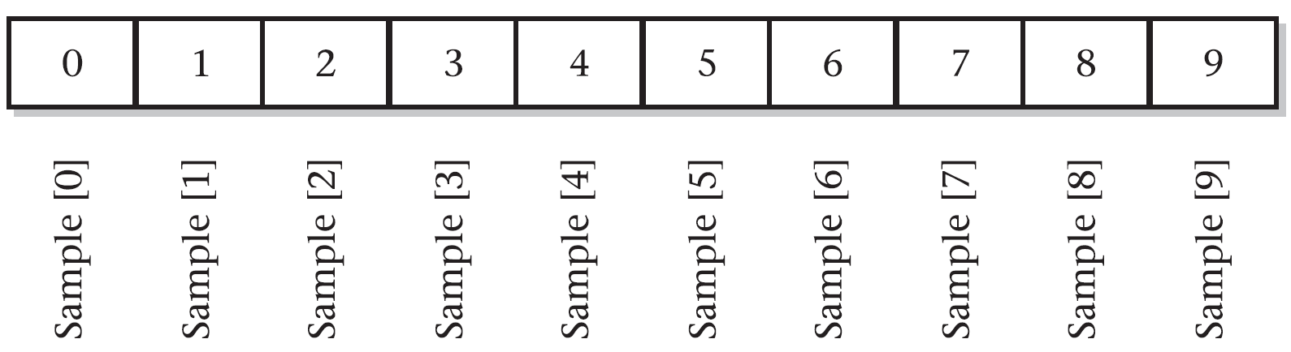
Data Types and Operators (Part 2) - Arrays
class ArrayDemo {
public static void main(String args[]) {
int sample[] = new int[10];
int i;
for(i = 0; i < 10; i = i+1) {
sample[i] = i;
}
for(i = 0; i < 10; i = i+1) {
System.out.println("This is sample[" + i + "]: " + sample[i]);
}
}
}

Slide 71
Data Types and Operators (Part 2) - Arrays
// Find the minimum and maximum values in an array.
class MinMax {
public static void main(String args[]) {
int nums[] = new int[10]; int min, max; nums[0] = 99; nums[1] = -10; nums[2] = 100123; nums[3] = 18; nums[4] = -978; nums[5] = 5623; nums[6] = 463; nums[7] = -9; nums[8] = 287; nums[9] = 49;
min = max = nums[0];
for(int i=1; i < 10; i++) {
if(nums[i] < min) min = nums[i];
if(nums[i] > max) max = nums[i];
}
System.out.println("min and max: " + min + " " + max);
}
}

Slide 72
Data Types and Operators (Part 2) - Arrays
// Find the minimum and maximum values in an array.
// Use an array initializer
class MinMax {
public static void main(String args[]) {
int nums[] = { 99, -10, 100123, 18, -978, 5623, 463, -9, 287, 49 };
int min, max;
min = max = nums[0];
for(int i=1; i < 10; i++) {
if(nums[i] < min) min = nums[i];
if(nums[i] > max) max = nums[i];
}
System.out.println("min and max: " + min + " " + max);
}
}
Array boundaries are strictly enforced in Java; it is a run-time error to overrun or underrun the end of an array. If you want to confirm this for yourself, try the following program that purposely overruns an array.

Slide 73
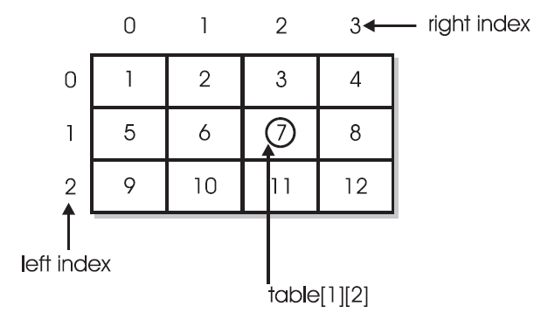
Data Types and Operators (Part 2) – Multidimensional Arrays
int table[][] = new int[10][20];
Two Dimensional Arrays are basically a grid.
// Demonstrate a two-dimensional array.
class TwoD {
public static void main(String args[]) {
int t, i;
int table[][] = new int[3][4];
for(t=0; t < 3; ++t) {
for(i=0; i < 4; ++i) {
table[t][i] = (t*4)+i+1;
System.out.print(table[t][i] + " ");
}
System.out.println();
}
}
}

Slide 74
Data Types and Operators (Part 2) – Irregular Arrays
// Manually allocate differing size second dimensions.
class Ragged {
public static void main(String args[]) {
int riders[][] = new int[7][];
riders[0] = new int[10];
riders[1] = new int[10];
riders[2] = new int[10];
riders[3] = new int[10];
riders[4] = new int[10];
riders[5] = new int[2];
riders[6] = new int[2];
int i, j;
// fabricate some fake data
for(i=0; i < 5; i++) {
for(j=0; j < 10; j++) {
riders[i][j] = i + j + 10;
}
}
for(i=5; i < 7; i++) {
for(j=0; j < 2; j++) {
riders[i][j] = i + j + 10;
}
}
}
System.out.println("Riders per trip during the week:");
for(i=0; i < 5; i++) {
for(j=0; j < 10; j++) {
System.out.print(riders[i][j] + " ");
}
System.out.println();
}
System.out.println();
System.out.println("Riders per trip on the weekend:");
for(i=5; i < 7; i++) {
for(j=0; j < 2; j++) {
System.out.print(riders[i][j] + " ");
}
System.out.println();
}
}
}
When you allocate memory for a multidimensional array, you need to specify only the memory for the first (leftmost) dimension. You can allocate the remaining dimensions separately. For example, the following code allocates memory for the first dimension of table when it is declared. It allocates the second dimension manually.
int table[][] = new int[3][];
table[0] = new int[4];
table[1] = new int[4];
table[2] = new int[4];

Slide 75
Data Types and Operators (Part 2) – Even more dimensions
Initializing Multidimensional Arrays
A multidimensional array can be initialized by enclosing each dimension’s initializer list within its own set of curly braces. For example, the general form of array initialization for a two-dimensional array is shown here:
type-specifier array_name[ ] [ ] = {
{ val, val, val, ..., val },
{ val, val, val, ..., val },
.
.
.
{ val, val, val, ..., val }
};
Arrays of Three or More Dimensions
Java allows arrays with more than two dimensions. Here is the general form of a multidimensional array declaration:
type name[ ][ ]...[ ] = new type[size1][size2]...[sizeN];
For example, the following declaration creates a 4 × 10 × 3 three-dimensional integer array.
int multidim[][][] = new int[4][10][3];
Here, val indicates an initialization value. Each inner block designates a row. Within each row, the first value will be stored in the first position of the subarray, the second value in the second position, and so on. Notice that commas separate the initializer blocks and that a semicolon follows the closing }.

Slide 76
Data Types and Operators (Part 2) – Alternate Declaration Syntax of Array
Here, the square brackets follow the type specifier, not the name of the array variable. For example, the following two declarations are equivalent:
int counter[] = new int[3];
int[] counter = new int[3];
The following declarations are also equivalent:
char table[][] = new char[3][4];
char[][] table = new char[3][4];
This alternative declaration form offers convenience when declaring several arrays at the same time. For example,
int[] nums, nums2, nums3; // create three arrays
This creates three array variables of type int. It is the same as writing int nums[], nums2[], nums3[]; // also, create three arrays
The alternative declaration form is also useful when specifying an array as a return type for a method. For example,
int[] someMeth( ) { ...

Slide 77
Data Types and Operators (Part 2) – Array References 101
Since arrays are objects, they are assigned by reference, meaning they copy a pointer in memory and share the data.
class AssignARef {
public static void main(String args[]) {
int i;
int nums1[] = new int[10];
int nums2[] = new int[10];
for(i=0; i < 10; i++) {
nums1[i] = i;
}
for(i=0; i < 10; i++) {
nums2[i] = -i;
}
for(i=0; i < 10; i++) {
System.out.print(nums2[i] + " ");
}
System.out.println();
// now operate on nums1 array through nums2
nums2[3] = 99;
System.out.print("Here is nums1 after change through nums2: ");
for(i=0; i < 10; i++) {
System.out.print(nums1[i] + " ");
}
System.out.println();
}
}

Slide 78
Data Types and Operators (Part 2) – Array Length
Using the length Member
Because arrays are implemented as objects, each array has associated with it a length instance variable that contains the number of elements that the array can hold. (In other words, length contains the size of the array.)
Since Arrays are by reference we can use the length member to inspect and create loop(s) to copy content to a new array.
// Use length variable to help copy an array.
class ACopy {
public static void main(String args[]) {
int i;
int nums1[] = new int[10];
int nums2[] = new int[10];
for(i=0; i < nums1.length; i++) {
nums1[i] = i;
}
// copy nums1 to nums2
if(nums2.length >= nums1.length) {
for(i = 0; i < nums1.length; i++) {
nums2[i] = nums1[i];
}
}
for(i=0; i < nums2.length; i++) {
System.out.print(nums2[i] + " ");
}
}
}

Slide 79
Data Types and Operators (Part 2) - Strings
Strings are arrays of char.
As such we can perform operations on strings.
Here’s a complete reference on String in Java for your review:
https://www.edureka.co/blog/cheatsheets/java-string-cheat-sheet/
https://www.w3schools.com/java/java_ref_string.asp

Slide 80
Data Types and Operators (Part 2) – Command Line Arguments
In Java, the main() function received an args[] array. So when the command line receives optional parameters, these are captured as parameters and available in your main() function.
Here’s documentation on this:
https://www.javatpoint.com/command-line-argument

Slide 81
Data Types and Operators (Part 2) - ? Operator
The ? Operator, also known as the ternary operator is a shortcut where we have a conditional statement and depending on true or false evaluation, it will return a value.
Here’s an example:
result = (i != 0) ? 100 / i : 0;
The long version
if(i ! = 0) {
result = (100 / i);
} else {
result = 0;
}

